Slide 1
GIS For Dummies Session 1: Why GIS?
Presented by Nicholas Barber, 2nd Year PhD Student at the University of Cambridge, U.K.
ndb38@cam.ac.uk | www.volcannick.com | https://github.com/ndb38 | Twitter @volcannick

Slide 2




Acknowledgements
Special thanks to Catherine, Sarah, and Robert for reaching out, developing the course with me, and putting together the logistics.

Slide 3
Workshop Structure
Today: Session 1 – Principles and Motivation for GIS in the Geosciences
Why GIS?
Principles of GIS
Getting acquainted with Quantum GIS?
Wednesday June 17th: Session 2 – Tutorial + Guagua Pichincha Exercise
Tour of Interface
Tutorial
Monday June 29th: Session 3 (GIS for the Intrepid) - Advanced GIS
Frontiers of GIS
Geostatistics
Python
Data Management
Advanced formatting
Wednesday July 1st: Scheduled “TA Hours” for 1-on-1 project advice

Slide 4
Outline of Today’s Session
Objectives (5 Minutes)
My Background (5 Minutes)
Why GIS? (10 Minutes)
Principles of GIS (30 Minutes)
Whirlwind Intro to QGIS
(20 Minutes)

Slide 5
Objectives
GIS = Geographic Information System
Definition:
“A GIS is a computer-based system to aid
in the collection, maintenance, storage,
analysis, output, and distribution of spatial
data and information.” – Paul Bolstad (GIS Fundamentals)

Slide 6
Questions you may have going into this workshop:
What is GIS?
What can it do for me and my research?
What’s the best GIS software?
How do I learn the ins and outs?
Topics from the interest form:
How do I use Landsat imagery for mineral exploration?
Which coordinate system is preferred?
How do I georeference a geological map?
How do I create a map of my field site?
Best practices for setting up a new project?
How do I automate QGIS tasks
with python scripts?
How do I connect to and query a spatial database?

Slide 7
My goals over the next few weeks
Highlight what GIS can do for geoscientists
Outline the key principles of a geographic information system
Providing a fully guided GIS workflow template
Identify key areas of growth for GIS in geoscience research

Slide 8
If you take nothing else away from this workshop….
GIS is a helpful tool in your workflow if you have data with a spatial dimension
GIS software lets you store, collect, analyze, and share spatial data
Modern GIS platforms like ArcMap and QGIS are all around workhorses – essential to tasks like spatial modeling, database management, cartography, geodesy, data visualization, hazard mitigation, and story telling
Learning the capabilities of GIS is acquired from repeated, often frustrating, trial and error with the hundreds of built-in tools
Studies should be designed with the GIS end user in mind!!!

Slide 9
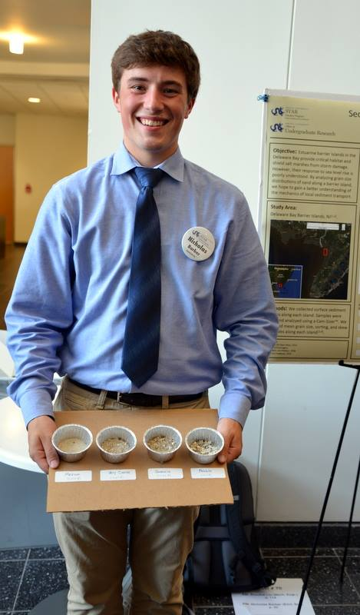
My Background
Past: B.S. Geoscience (Honors), Drexel University, USA
Current: PhD Earth Science, Cambridge, UK
Specialty Areas: Volcanology, Igneous Geochemistry
GIS Experience:
August 2014 - Present

Slide 10
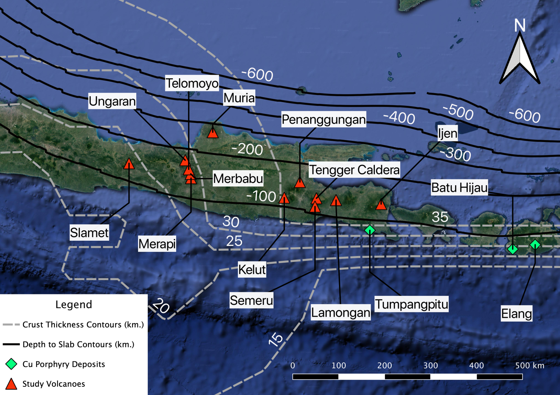
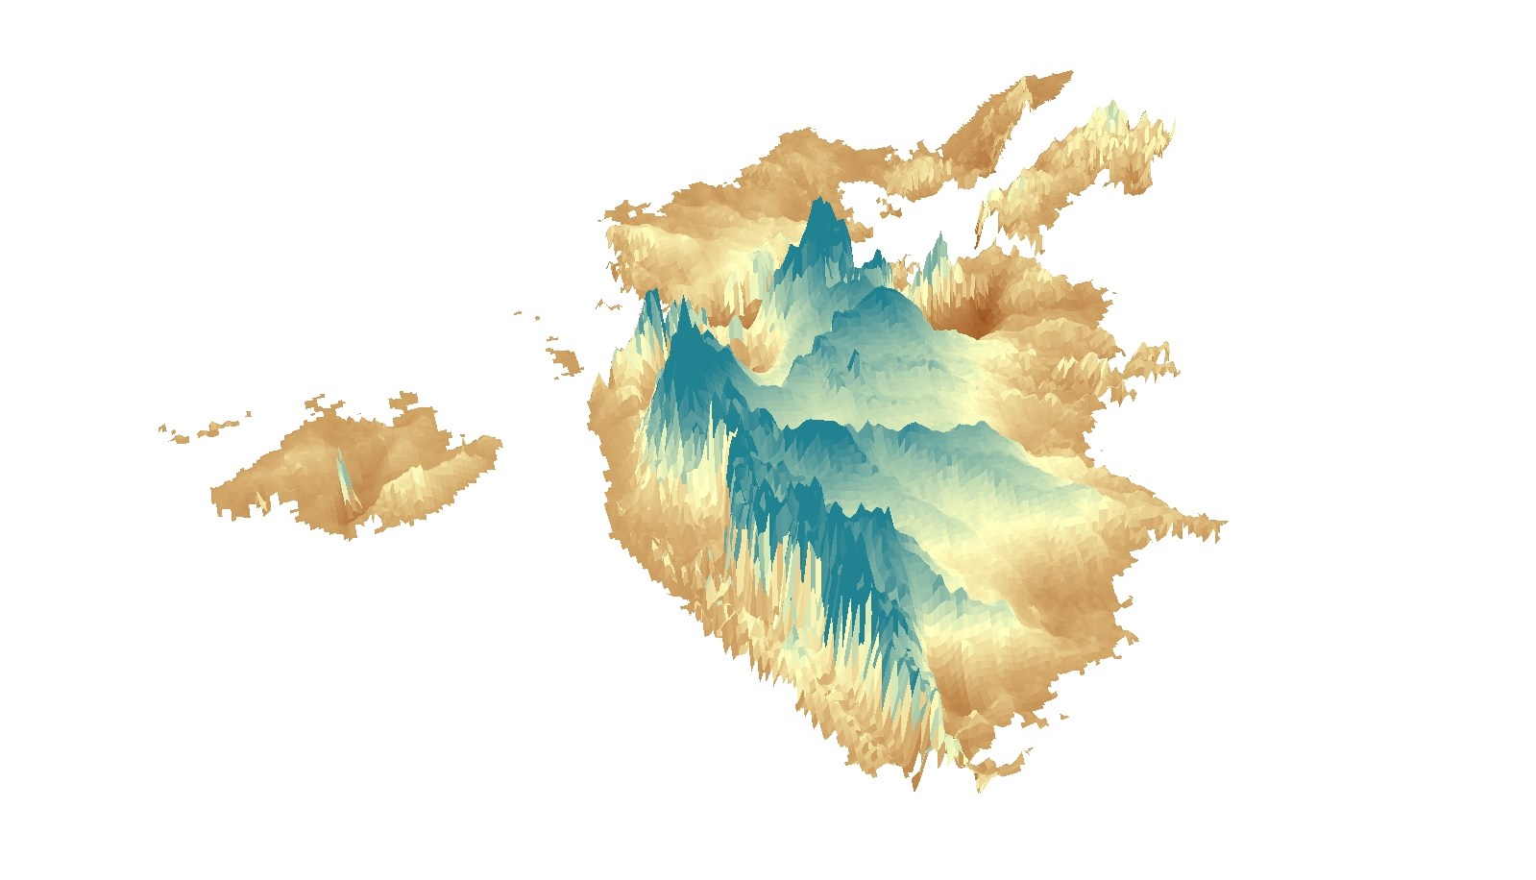
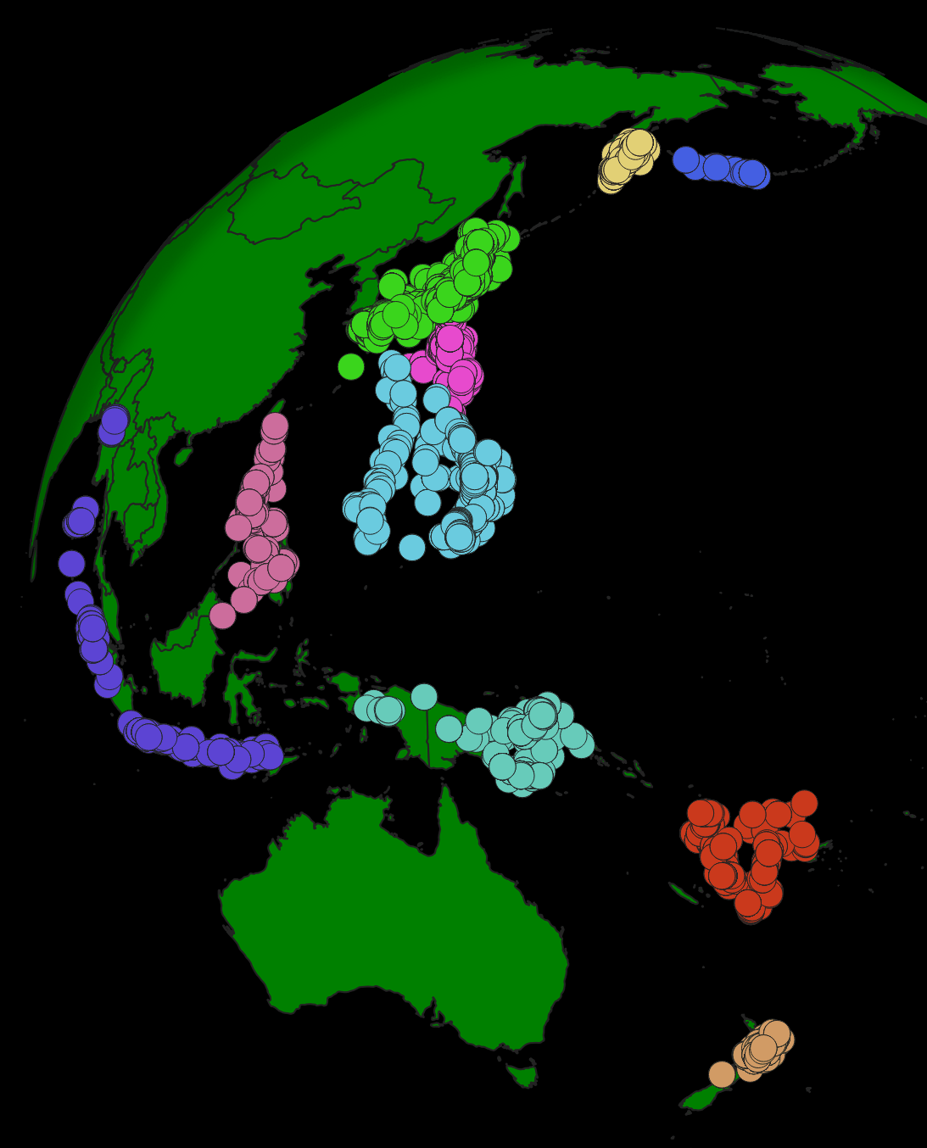
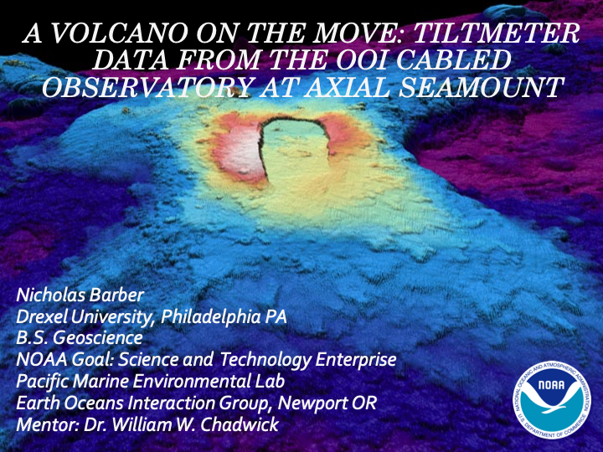
(Above) September 2018 to Present: Metals in Magmas Field Campaign, Java, Indonesia
(Below + Right) January 2016 to Present: Senior Project Volume of Deccan Traps
(Right) August 2019 to Present): SlabMetals2 Glocal Arc Chemistry Database
(Right) May 2017 to August 2017: Deformation modeling with NOAA; Seafloor volcano Axial Seamount

Slide 11
Why GIS?
Motivations for the strapped-for-time earth scientist

Slide 13
Principles of GIS
Working Principles → Data Sources + Management → Projections → Data Types → Errors → Layout → Software

Slide 15
Introducing QGIS 3.10
A fly-by-tour of the best open source GIS software – Quantum GIS

